Slide 1

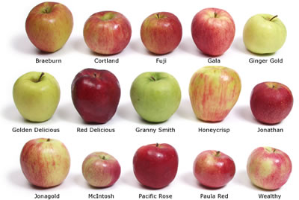


‘Anything goes’ diverse projects
Limited scope, ‘themed’ projects

